Slide 1
NeuroWell
-Byte Buddies:
Deekshith B and Sanjana WG

Slide 2
Project Brief
Neuro Well is an innovative platform designed to enhance the diagnosis and rehabilitation process for stroke patients. Strokes are a leading cause of disability worldwide, affecting approximately 15 million people each year and resulting in significant mortality and long-term disability. The platform aims to address the critical need for rapid and accurate stroke assessment and personalized rehabilitation plans. Neuro Well leverages advanced technologies such as computer vision and speech analysis to conduct comprehensive evaluations of cognitive, motor, and speech abilities. These assessments, assist healthcare professionals in diagnosing the type and severity of the stroke and formulating effective rehabilitation strategies. The goal is to provide timely, data-driven insights that facilitate early intervention and improve patient outcomes, ultimately contributing to better quality of life for stroke survivors.

Slide 3
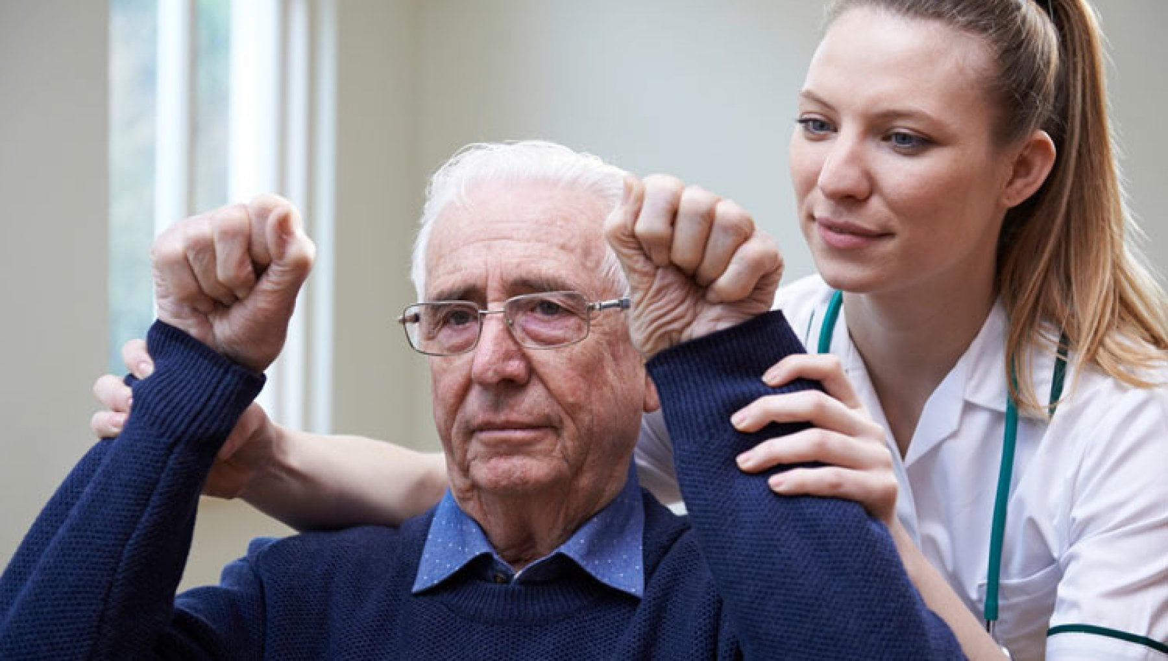
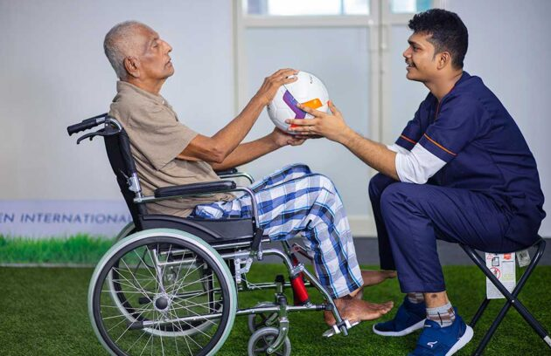
Statistics
Recovery and Rehabilitation:
10% of stroke survivors recover almost completely.
25% recover with minor impairments.
40% experience moderate to severe impairments requiring special care​ (AOTA)​ .

Slide 4
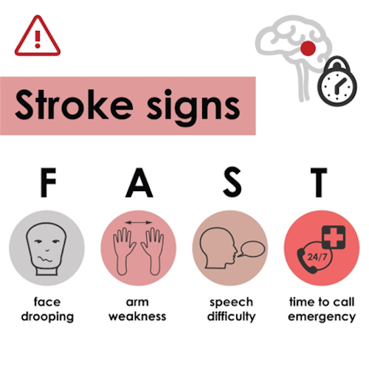
Understanding the Variability of Stroke Impairments
Vision Impairments: Strokes affecting the occipital lobe or the optic pathways can lead to vision loss or difficulties, such as double vision or loss of visual fields.
Cognitive and Speech Impairments: Damage to the brain's language centers, such as Broca's area or Wernicke's area, can result in aphasia, impacting speech production and comprehension.
Motor Impairments: Strokes that affect the motor cortex can lead to hemiparesis (weakness on one side of the body) or hemiplegia (paralysis on one side of the body), significantly impacting mobility and daily functioning.
Sensory Impairments: Some strokes may cause loss of sensation or abnormal sensations (paresthesia) in certain body parts, complicating the ability to perform routine activities.

Slide 5
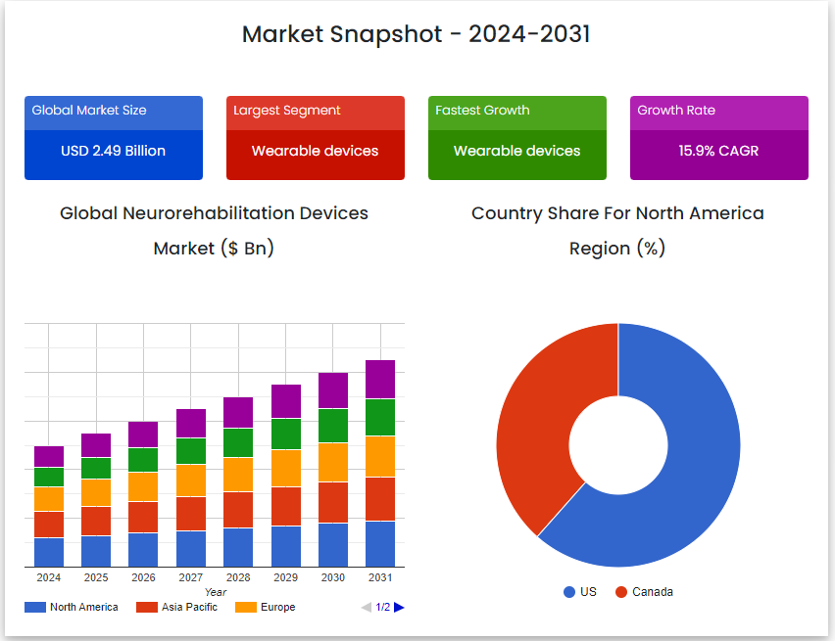
Market Size
Global Neurorehabilitation Devices Market size was valued at USD 2.49 Billion in 2022 and is poised to grow from USD 2.89 Billion in 2023 to USD 9.40 Billion by 2031, at a CAGR of 15.9% during the forecast period (2024-2031).

Slide 6
Importance of Early and Accurate Assessment
Timely Intervention: Early assessment allows for the rapid initiation of treatments like thrombolysis or thrombectomy, which can significantly reduce the severity of long-term impairments.
Customized Treatment Plans: Accurate assessment ensures that rehabilitation plans are tailored to the specific needs of each patient, addressing their unique impairments and promoting better recovery outcomes.
Monitoring Progress: Ongoing assessments help healthcare providers track recovery progress and adjust treatment plans as needed to maximize patient improvement.

Slide 7
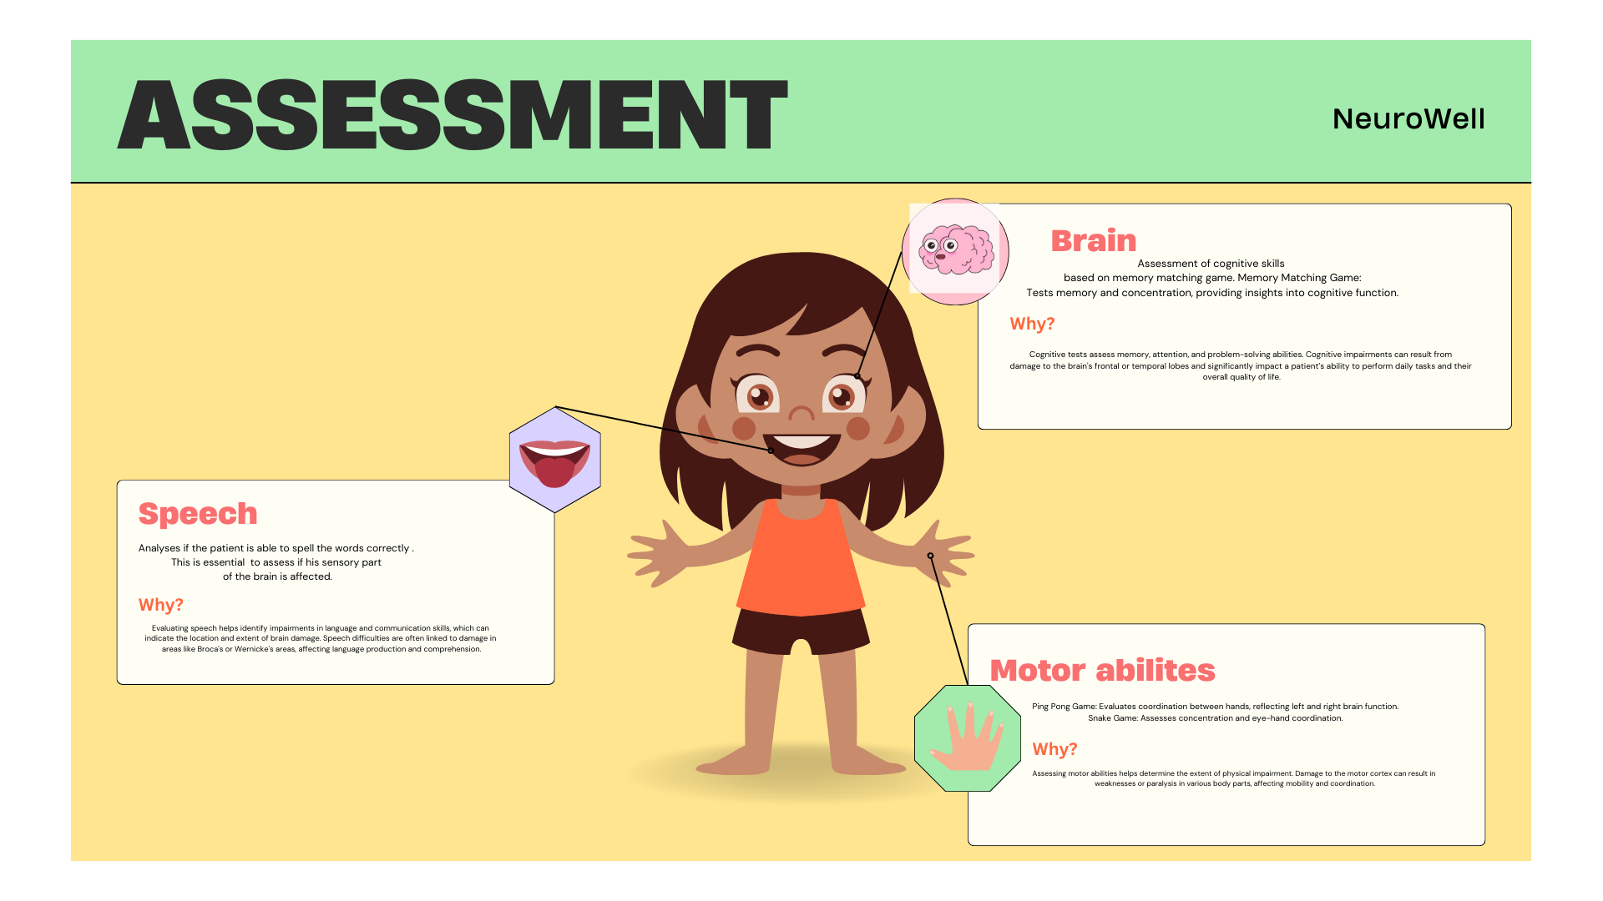

Slide 8
Assessment Criteria
The National Institutes of Health Stroke Scale (NIHSS) is a systematic, quantitative assessment tool to measure stroke-related neurological deficit[1]. In clinical practice it can be used to evaluate and document neurological status in acute stroke patients, determine appropriate treatment and assist in standardizing communication between healthcare practitioners[2]. The NIHSS has been shown to be a predictor of both short and long term outcomes of stroke patients.
Stroke severity may be stratified on the basis of NIHSS scores as follows:
Very Severe: >25
Severe: 12 – 24
Mild to Moderately Severe: 5 – 12
Mild: 1 – 5'

Slide 9
Patient’s Login
Simple Physio Exercises
Description: A library of guided physical exercises designed to support rehabilitation. These exercises are categorized based on the patient's level of impairment and are easy to follow at home.
Why It's Useful: Regular physical activity is crucial for stroke recovery. By offering simple and accessible exercises, Neuro Well helps patients maintain and improve their mobility, strength, and overall physical health, which is essential for a successful recovery.
Community Section
Description: An interactive community platform where patients can connect with others, share their experiences, and provide emotional support. This section includes forums, chat rooms, and virtual support groups.
Why It's Useful: Emotional support is a vital component of the rehabilitation process. The community section offers a space for patients to interact with others who understand their challenges, reducing feelings of isolation and promoting mental well-being. Sharing experiences and receiving encouragement from peers can significantly enhance motivation and adherence to rehabilitation plans.

Slide 10
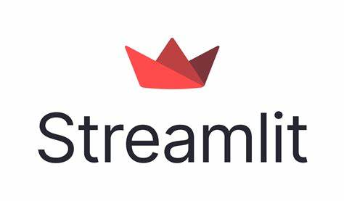

Tech Stack
Frontend
Streamlit: Interactive Web Interface
Data Management
Google Sheets: Patient Score Storage
AI Models
Regression AI Model: Predictive Analytics
Speech Recognition Model: Speech Analysis

Slide 11
Computer Vision
MediaPipe: Real-Time Hand Tracking
OpenCV: Image Processing
CVZone: Game Integration
Natural Language Processing
Google Translate: Multilingual Support
Data Analysis
Pandas: Data Manipulation
NumPy: Numerical Computations
Matplotlib (pyplot): Graphical Representation
Additional Tools
Python: Core Programming Language
Scikit-Learn: Machine Learning

Slide 12
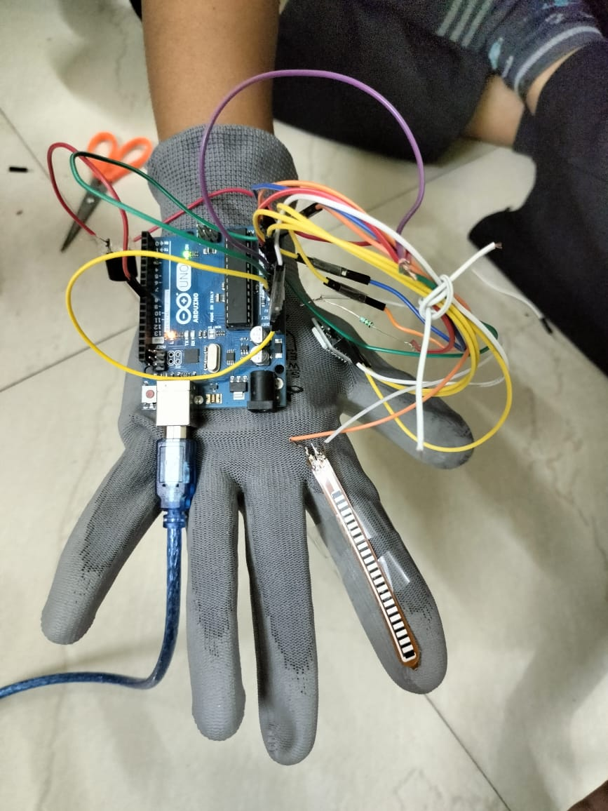
Future Prospects for Neuro Well
Integration with Advanced Rehabilitation Technologies
Exoskeletons:
Description: Robotic exoskeletons are being developed to assist patients with severe motor impairments. These wearable devices support and enhance limb movements, enabling patients to perform physical activities they might not be able to do independently.
Future Integration: Neuro Well can incorporate data from exoskeleton usage to monitor and analyze patient progress in real-time. By integrating this technology, our platform can provide detailed insights into how the exoskeleton aids recovery and adjust rehabilitation plans accordingly.
Source: Harvard Gazette - Exoskeleton Technology

Slide 13
AI and Machine Learning Enhancements
Predictive Analytics:
Description: Using AI and machine learning to predict patient outcomes based on their assessment data and progress trends.
Future Integration: Neuro Well can leverage these technologies to provide more accurate and personalized rehabilitation plans. Predictive models can help anticipate potential complications and suggest preventive measures.
Source: MIT Technology Review - AI in Healthcare
Telemedicine and Remote Rehabilitation
Description: Telemedicine platforms enable remote consultations and monitoring, providing patients with access to medical care from the comfort of their homes.
Future Integration: Neuro Well can expand to include telemedicine features, allowing healthcare providers to conduct remote assessments and adjust rehabilitation plans based on real-time data. This approach can make stroke rehabilitation more accessible, especially for patients in remote or underserved areas.
Source: American Stroke Association - Telehealth in Stroke Care

Slide 14
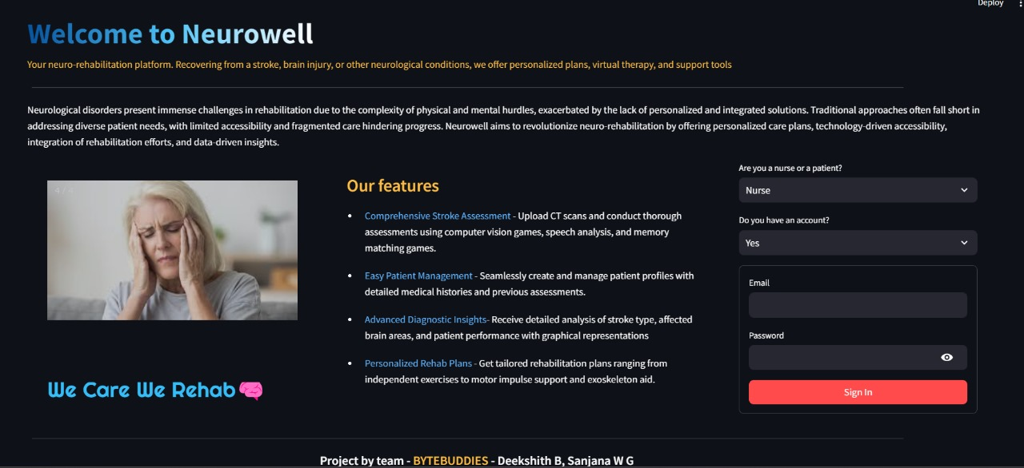
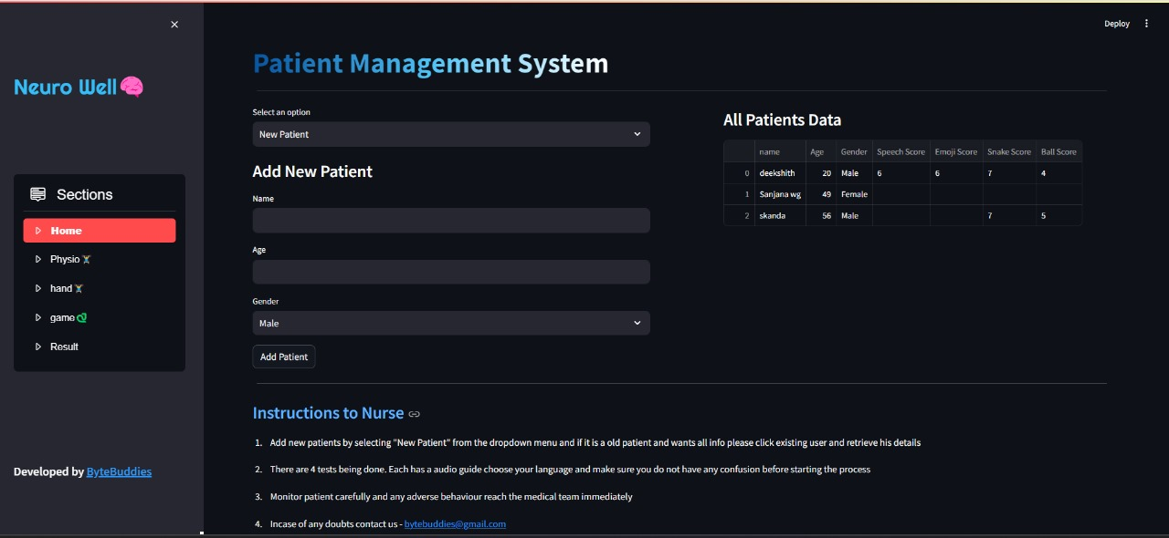
Project Snaps

Slide 15
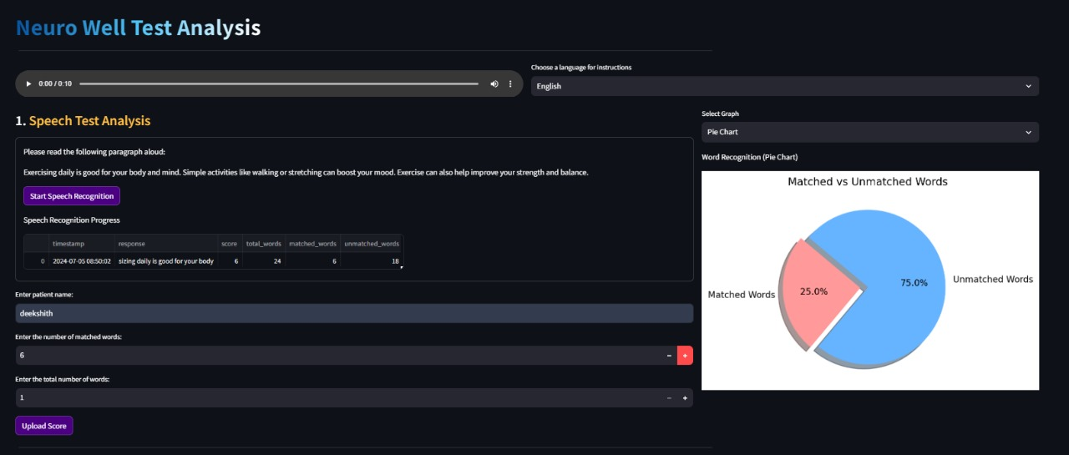
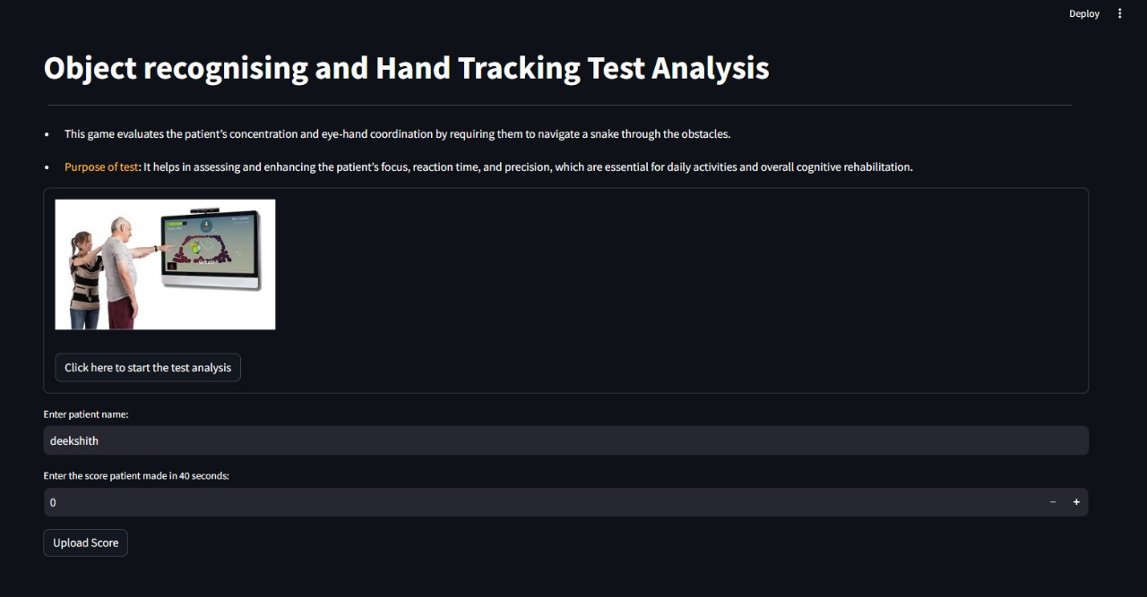
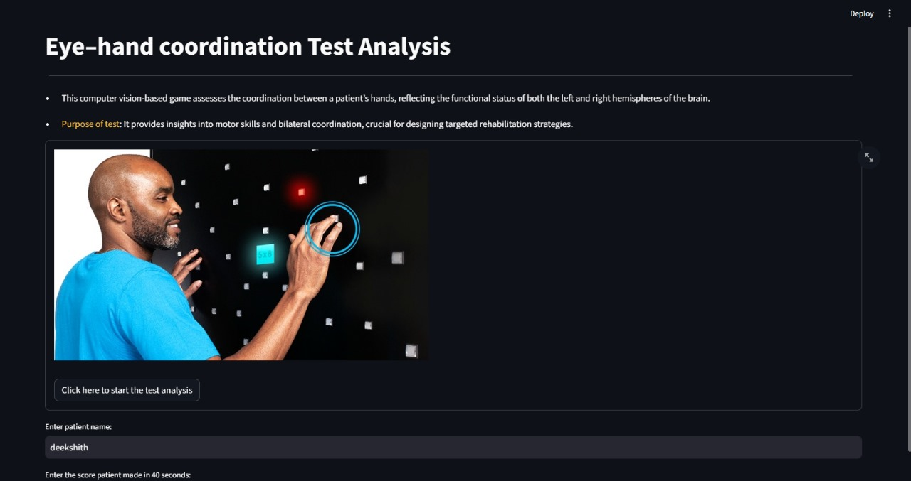
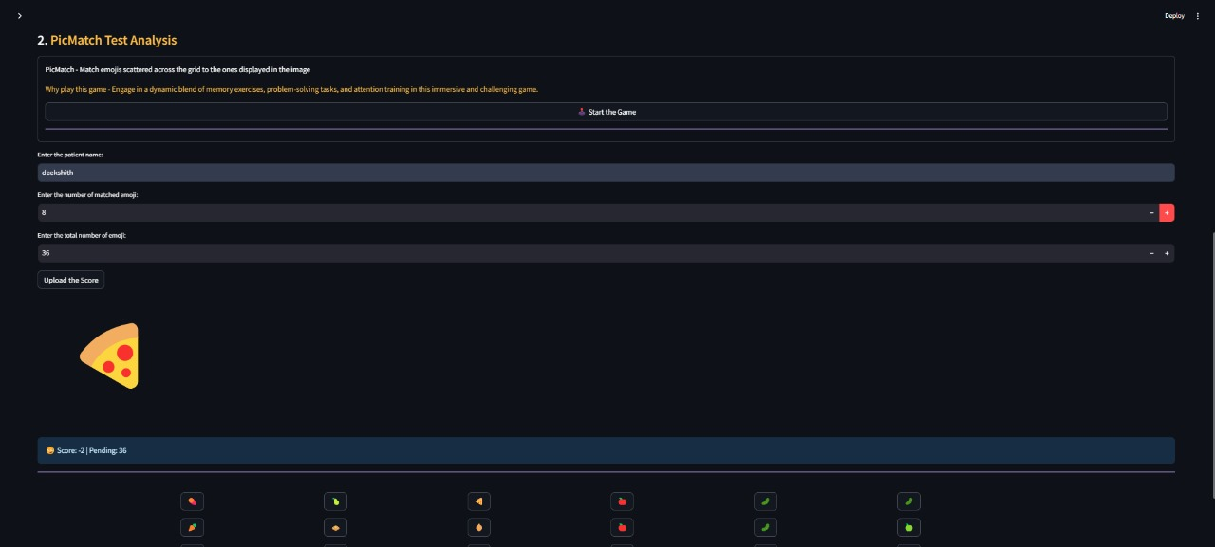

Slide 16
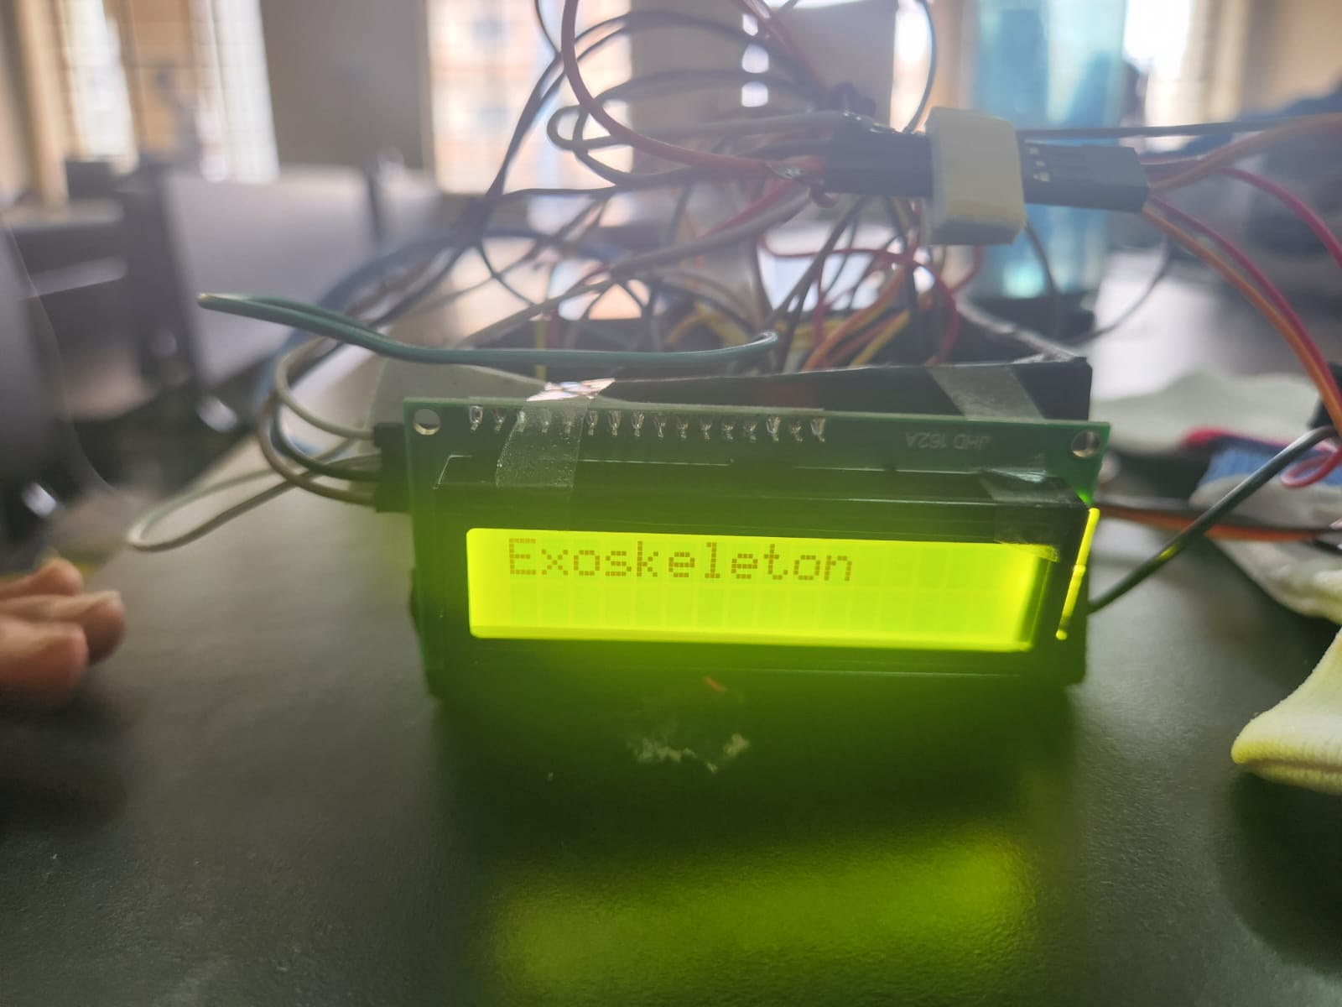
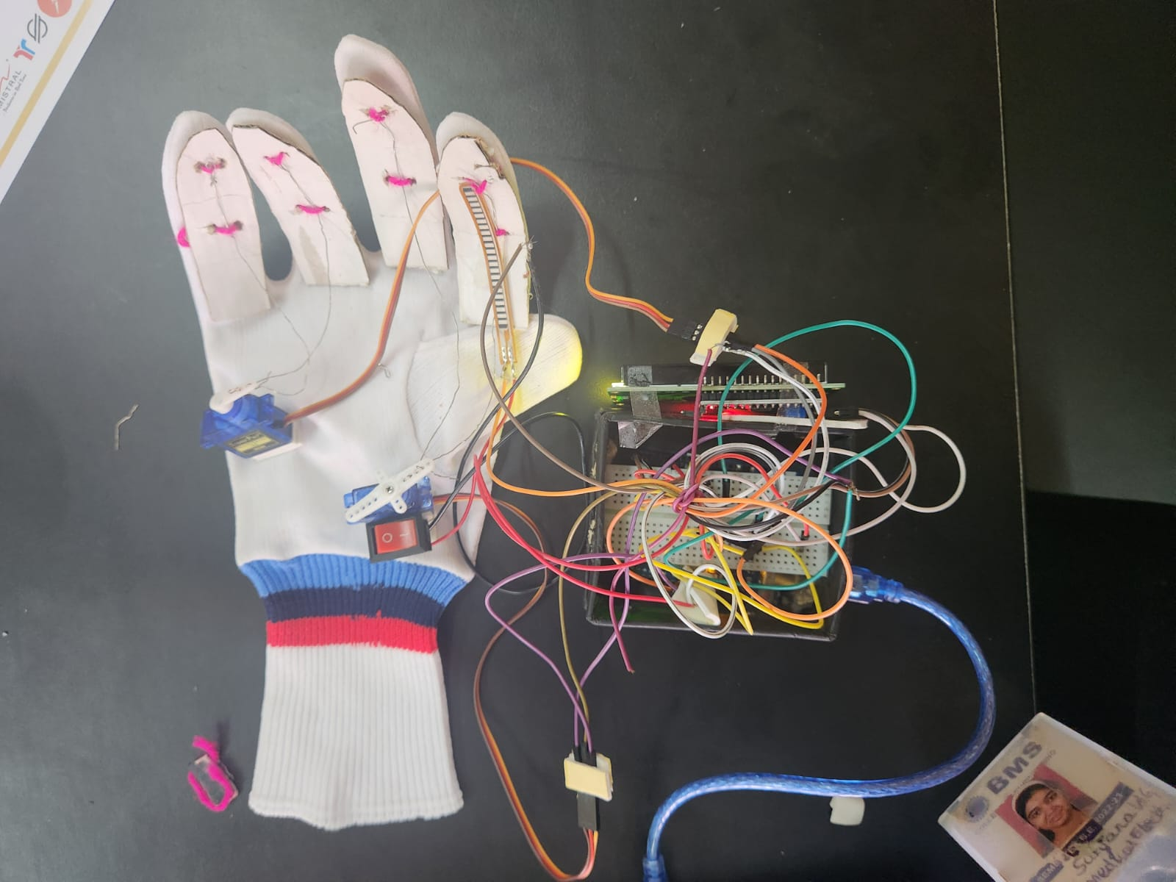
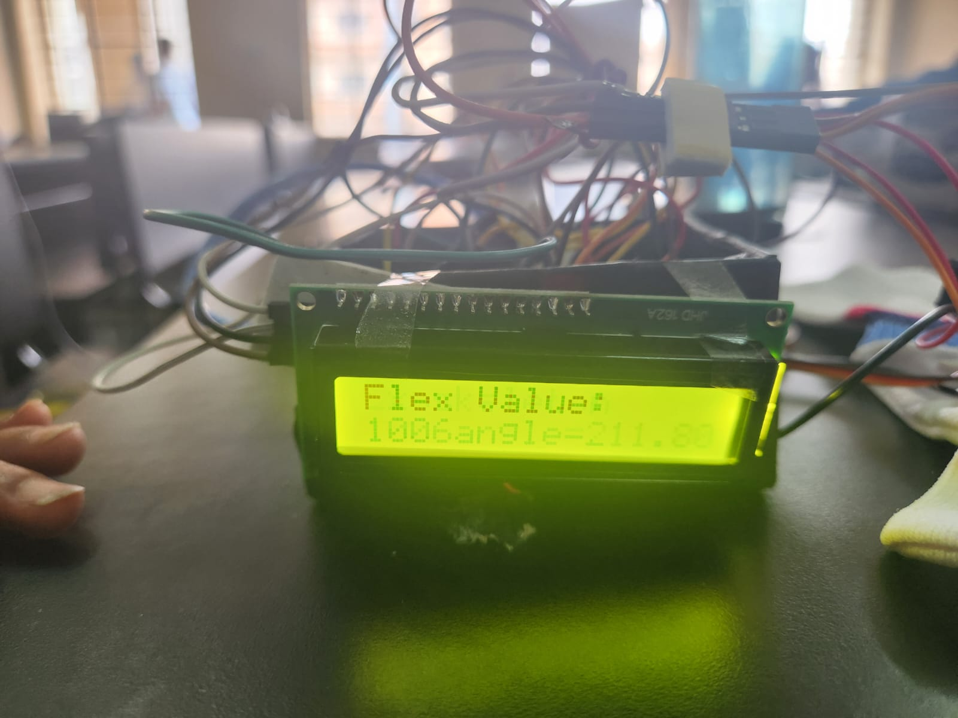

Slide 17
Transforming Stroke Rehabilitation with Neuro Well- Conclusion
Neuro Well is revolutionizing stroke rehabilitation with a data-driven, patient-centric approach that merges cutting-edge technology with compassionate care. By harnessing the power of advanced assessments, personalized treatment plans, and real-time progress tracking, we enable healthcare professionals to deliver targeted and effective interventions. Our integration of AI, wearable tech, and innovative rehabilitation tools ensures that patients receive the best possible care tailored to their unique needs. As we look to the future, Neuro Well remains committed to continuous innovation, setting new standards in stroke recovery and empowering patients to reclaim their lives with dignity and independence. Together, we are transforming the landscape of stroke rehabilitation, one patient at a time.

